Slide 1

#LifeKoKaroLift
Post-Graduate Diploma in ML/AI

Slide 2



Course : Machine Learning
Lecture On : RL Pre-Assignment
Instructor : Manish Kumar

Slide 3

Session - Agenda
Problem statement
Understanding MDS Rules
Env Code Walkthrough ☺
Q-Learning
Agent Code Walkthrough ☺

Slide 4
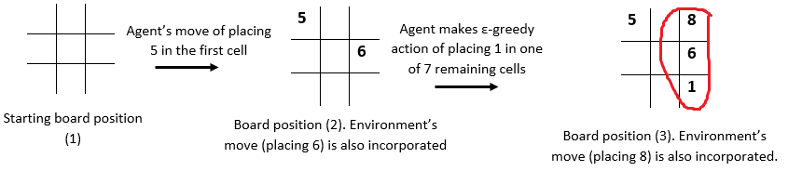
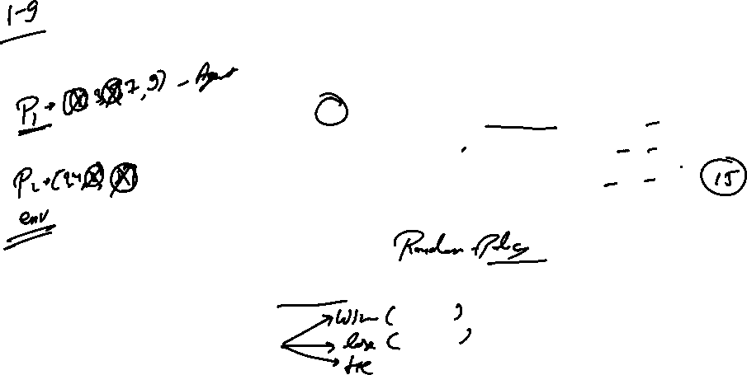
Numerical Tic-Tac-Toe
In this assignment, you need to build an RL agent that learns to play Numerical Tic-Tac-Toe with odd numbers (the agent will always make the first move). You need to train your agent using Q-Learning. The environment is playing randomly with the agent
The player who puts down 15 points in a line - (column, row or a diagonal) wins the game.

Slide 5
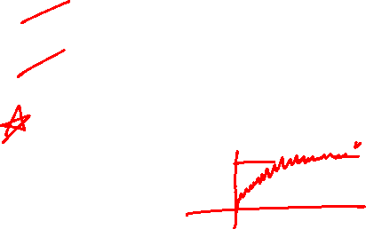

Numerical Tic-Tac-Toe
You need to accomplish following in this assignment
Create an MDP for Numerical Tic-Tac-Toe game
Build an agent that learns the game by Q-Learning
Check whether Q-values learnt by the agent have converged or not

Slide 6
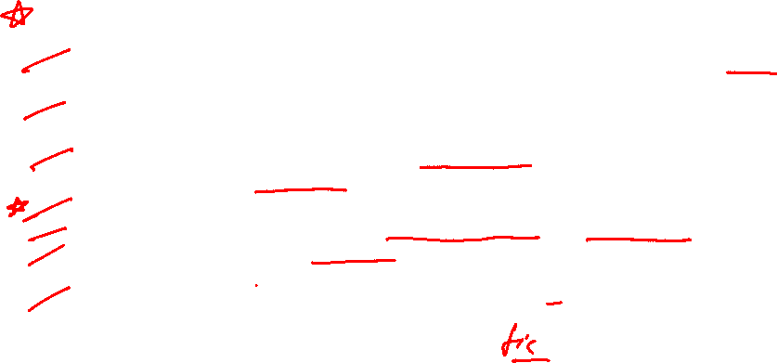
Numerical Tic-Tac-Toe
Rules of the Game:
The game will be played on a 3x3 grid (9 cells) using numbers from 1 to 9. Each number can be used exactly once in the entire grid.
There are two players: one is the Reinforcement Learning (RL) agent and other is the environment.
The RL agent is given odd numbers {1, 3, 5, 7, 9} and the environment is given the even numbers {2, 4, 6, 8}
Each of them takes a turn. The player with odd numbers always goes first.
At each round, a player puts one unused number on a blank spot.
The objective is to make 15 points in a row, column or a diagonal. The player can use the opponent's numbers in the grid to make 15.
The game terminates when any one of the players makes 15.

Slide 7

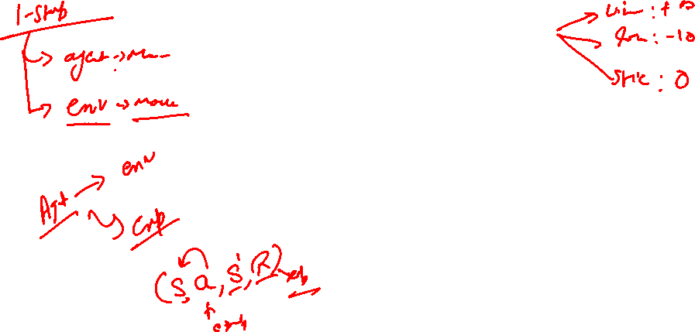
Let’s Look at the Environment file

Slide 8




RL - Equations
“ The state-value function V𝜋(s) of an MDP is the expected return starting from state S, and then following policy 𝜋 ”
“ The action-value function q𝜋(s, a) is the expected return starting from state s, taking action a, and following policy 𝜋 ”

Slide 9
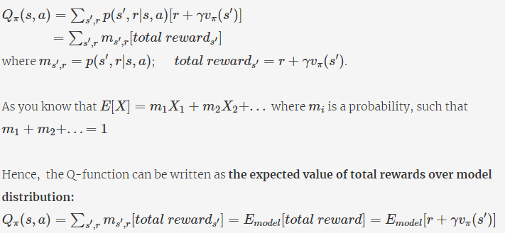
Model-Free Method
The equations can be solved if the model of the environment p(s′,r|s,a) is available. In most real-life scenarios with large state and action spaces, the model of the environment is not available (i.e. model-free methods). In such cases, you can compute the q-function using the fact that it is the expected value of the total reward

Slide 10
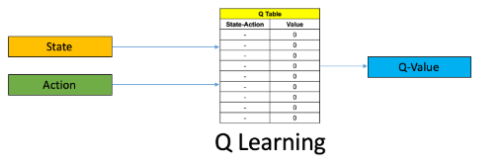
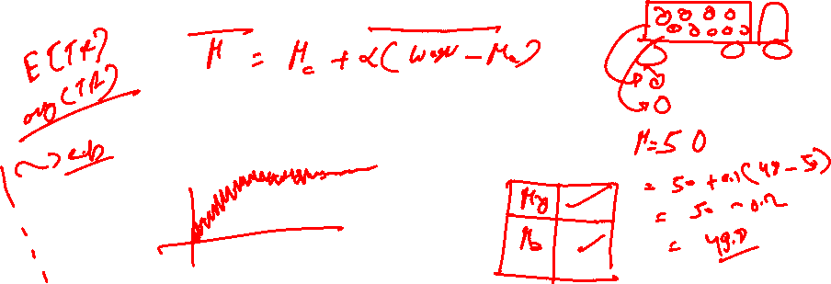
Q-Learning
In Q-learning, you do max-update. After taking action a from state s, you get an immediate reward of r and land in a new state s′. From s′, you take the most greedy action, i.e., the action with the highest q-value.

Slide 11
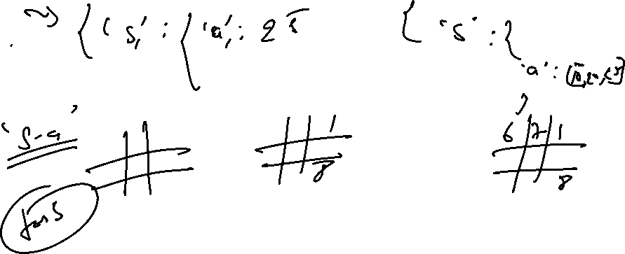

Slide 14
Let’s see the starter code now !

Slide 15
#LifeKoKaroLift
Thank You!
Introduction to Reinforcement learning by Sutton and barto
https://web.stanford.edu/class/psych209/Readings/SuttonBartoIPRLBook2ndEd.pdf

